Slide 1
Agency for Persons with Disabilities
House Children, Families and Seniors Subcommittee
January 7, 2015
Rick Scott Governor
Barbara Palmer
Director

Slide 2

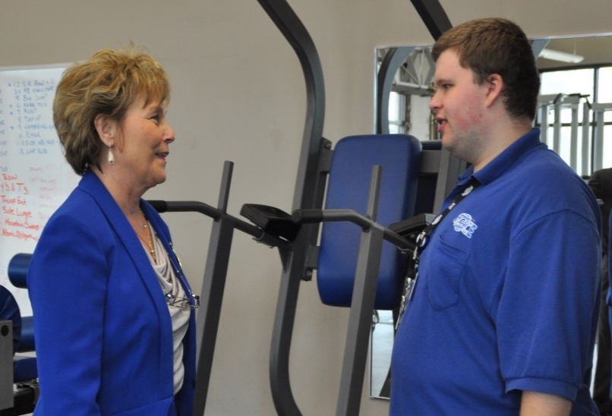

Mission
The Agency Supports Persons with Developmental Disabilities in Living, Learning, and Working in their Communities.
2
Notes:
2

Slide 3
Legislative Focus
    S. 393.062, F.S.: “…the greatest priority shall be given to the development and implementation of community-based services that will enable individuals with developmental disabilities to achieve their greatest potential for independent and productive living, enable them to live in their own homes or in residences located in their own communities, and permit them to be diverted or removed from unnecessary institutional placements….”

Slide 4

Who Do We Serve?
To be eligible for APD services, a person must have one or more of the following diagnoses:
  Autism
  Cerebral Palsy
  Down syndrome
  Intellectual Disability
  Prader-Willi Syndrome
  Spina Bifida
  High Risk of Developmental Disability (age 3-5)
4
Notes:
4

Slide 5
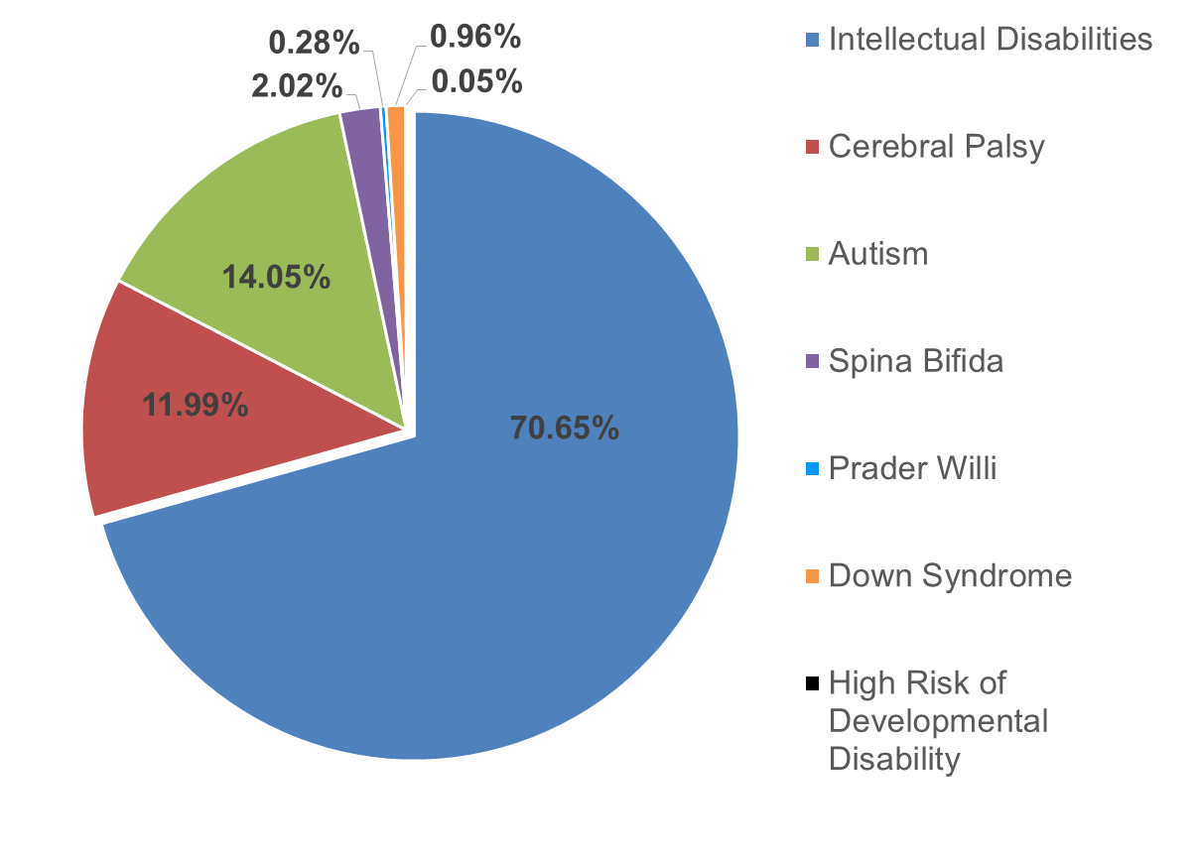
Who Do We Serve – By Primary Disability

Slide 6
Agency Priorities
APD is focused on five priorities and works to meet and exceed these priorities every day:
Employment - People with developmental disabilities who desire work are competitively employed
Quality Services - Measure and track performance to ensure the highest quality care
Waiting List - APD adopts national and local best practices to serve people on the waiting list efficiently and effectively
6
Notes:
6

Slide 7
Agency Priorities, Continued
APD is focused on five priorities and works to meet and exceed these priorities every day:
Fiscal Accountability - APD operates within the limits set forth in the General Appropriations Act
Thriving Providers/Businesses - Review rates, evaluate, and reduce regulatory hurdles to enable providers to serve customers with the highest standards of health and safety
7
Notes:
7

Slide 8
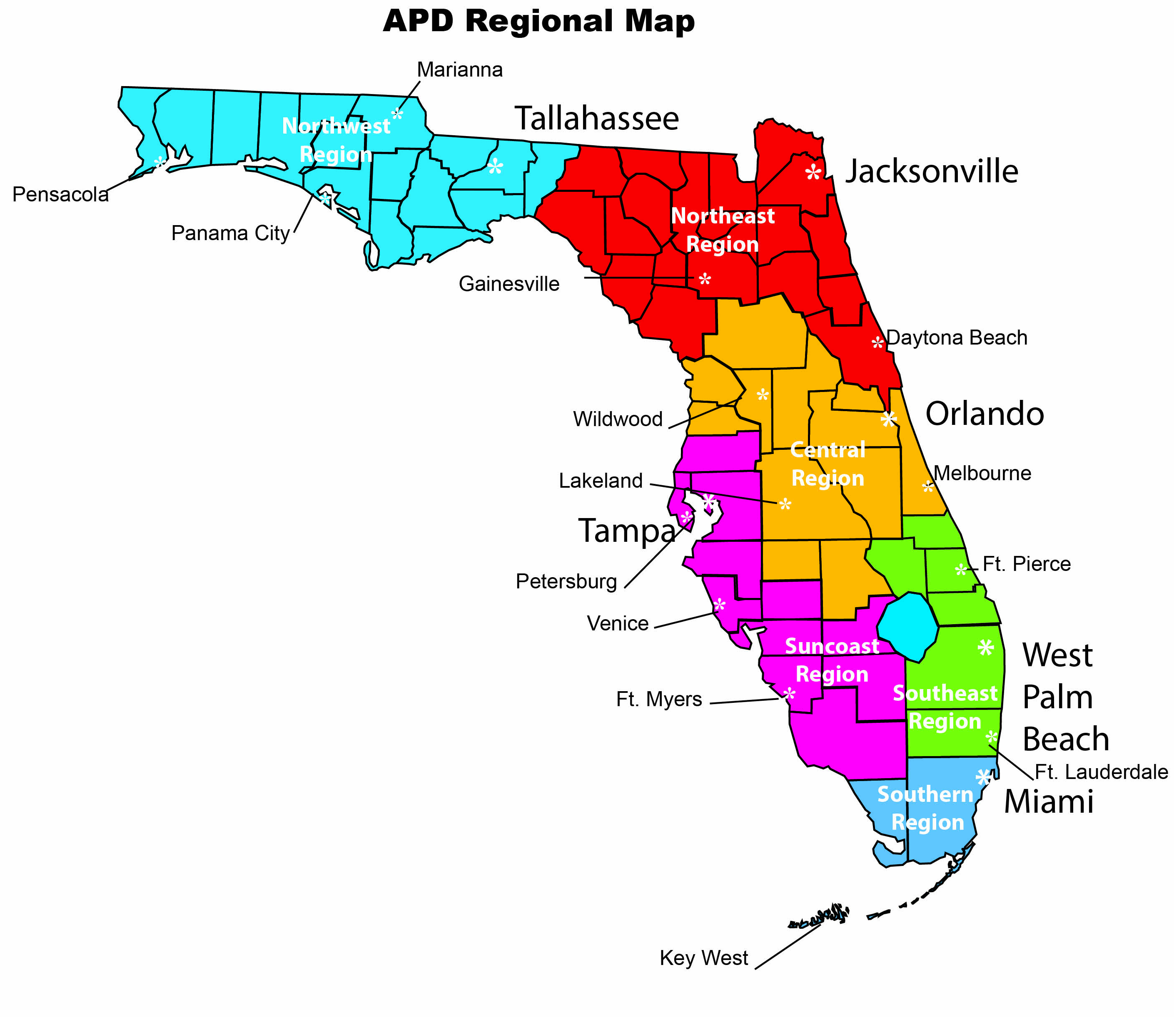
8
Notes:
8

Slide 9
Agency Appropriations – FY 2014-15
9

Slide 10
Medicaid Home and
Community-Based Services Waiver
Provides services in the community in lieu of more restrictive and expensive institutional programs
  Individuals reside in family homes, group homes or their own home
  Examples of services are therapies, respite, personal supports, companion, support coordination, residential services, and supplies and equipment
  Individuals may work or gain job-related skills through supported employment or adult day training
State matches the federal Medicaid dollars
  40.44% state dollars to 59.56% federal dollars

Slide 11
iBudget
Simplicity, Equity, Self-Direction, Sustainability
HCBS waiver program created by the Legislature and approved by the federal government
Provides for predictable spending within the agency’s legislative appropriation
Offers customers wider choices, more control, and greater flexibility in spending their yearly budget to best meet their needs

Slide 12
Waiver Support Coordinator
Assists each individual on waiver to:
  Create a personalized support plan
  Identify personal goals and needed services
  Manage their iBudget by creating service authorizations and contacting providers
  Submit information to the agency about additional service needs or additional funding requests
Meets regularly with the individual to ensure services are delivered properly

Slide 13
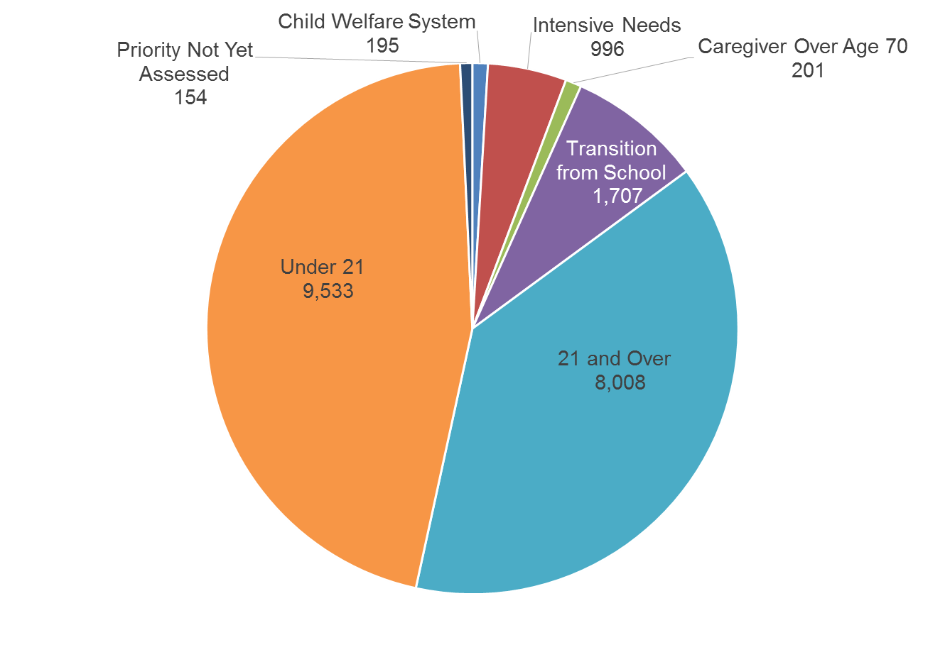
Waiver Waiting List Overview
Total Waiting List by Category
Total = 20,794
Source: APD Agency Allocation, Budget, and Contract Control (ABC) System as of October 1, 2014
13

Slide 14



Individual and Family Supports
Primary funding source to provide critical, temporary or emergency services to individuals on the waiting list
Funding sources are federal Social Services Block Grant and General Revenue dollars

Slide 15
Developmental Disability Centers (DDCs)
State-operated Intermediate Care Facilities for the Developmentally Disabled that are funded by the Medicaid program
Forensic programs that are funded by State Funds
DDCs include Sunland, Tacachale, and the Developmental Disabilities Defendant Program

Slide 16
Intermediate Care Facility/
Developmental Disability
Privately operated and funded by Medicaid program, and licensed and administered by Agency for Health Care Administration
APD authorizes admissions, determines the level of care of each resident, and performs continued stay reviews every six months

Slide 17
Waiver Expenditures vs. Appropriations
* Final appropriations include any supplemental appropriations and budget amendments. Updated as of 12/22/14.
17

Slide 18
FY 2014-15 Budget
Eliminates Critical Needs Portion of Waiting List
Governor recommended and Legislature approved
  $8.1 million in General Revenue, $11.9 million in Trust Funds = $20 million total funds
Enrolled on the waiver approximately 1,200 individuals on the waiting list with critical needs:
  Intensive behavioral and/or medical needs
  Cared for by caregivers with health limitations
APD estimates all individuals with critical needs waiting as of July 1, 2014, were offered waiver enrollment

Slide 19
Resource Directory
Great Tool for Individuals and Families
Link: www.apdcares.org/resourcedirectory
About 200 hits per day – over 115,500 visitors so far
Includes over 7,300 resources
Top 5 keyword searches last month: Group Homes, Adult Day Programs, Independent and Supported Living Services, In-Home Support, Respite
Includes an events calendar where individuals can look up disability related events, seminars, and recreational activities in their communities. Over 1,900 local events added to the calendar.

Slide 20
Thank you
Barbara Palmer, Director
Barbara.Palmer@apdcares.org
apdcares.org

